Slide 1


Slide 2

Setting up your frame
How do deal with an asynchronous world
Dan Baker
Oxide Games

Slide 3
Shift in responsibilities
Old API design: driver/API (mostly) responsible for synchronicity
Now it is your responsibility
With great responsibility comes great power

Slide 4
Waling through the queues
Certain design patterns will greatly reduce the chance of error
Plan out how you build your frame
If you can deal with aysnc between GPU and CPU, threading CPU should be much simpler

Slide 5
Simple example
Not going to dive into how to thread
First step is to deal with the asyncronous nature of CPU and GPU
Examples will be given as D3D12 specifics, but almost identical in Vulkan
Two types of data: frame data, and global data

Slide 6
Queues
In D3D11, application just performed an API call
  But this usually meant the command got placed in some driver queue
In Vulkan/D3D12, application will have it’s own queues instead. Driver is much shallower

Slide 7
Lots of Software Queues
Even Frame
Odd Frame
Apllication
Delete Queue
Delete Queue
Delete Queue
Res Copy Queue
Res Copy Queue
Transition Queue
Transition Queue
Fence Data
ReadBack Queue
Dynamic Data
ReadBack Queue
GPU

Slide 8
Basic hints
Get rid of the idea of a reused dynamic buffer
  They are fiction anyway
  Issue a copy if needed, it will be fast
  Don’t count on constants persisting across frames – no performance reason to architect for this
Actions take place on the whole frame, not on the order of calls
Everything happens indirectly – you’re adding actions to a queue

Slide 9
Topology of your App
BeginFrame()
AddCommands()
  Not going to cover in this talk
CreateResource()
DeleteResource()
ReadbackResource()
Present()

Slide 10
The Frame Data
#define QUEUED_FRAMES 2
struct Frame
{
ID3D12Fence *pFence;
uint uFenceValue;
DeleteList<ID3D12Resource*> ResourceDeleteList;
DeleteList<DescriptorSetSlot> SlotList;
ID3D12CommandAllocator *pCommandAllocator;
ID3D12Resource *pDynamicData;
void *pDynamicPlace;
ID3D12DescriptorHeap *pDynamicDescriptors;
ReadBackList ReadBacks;
};
uint32 g_uCurrentFrame;
Frame g_Frames[QUEUED_FRAMES];

Slide 11
Global Data
uint32 g_uCurrentFrame;
Frame g_Frames[QUEUED_FRAMES];
DeleteList g_GlobalDeleteList;
//In D3D12, we don’t need separate commands buffers
// because it’s the memory of the command that must be
//unique per frame, not the command buffer
ID3D12CommandBuffer *pCommandList;
//When resources are created, there may be GPU commands that need to be
//executed. In our system This queue will be submitted before any other //requests
ResourceCreationList g_CreationList;
ResourceCreatoinTransitionList g_TransitionList;

Slide 12
Begin Frame
Waits on GPU Fence
Maps dynamic memory buffers
  (No evidence that GPU memory needs to be persisently mapped)
Reset Command allocator (or cmd buffer)
Perform read backs (more on this later)

Slide 13
BeginFrame
//Select our frame
ThisFrameData = g_Frames[g_uCurrentFrame % 2];
//Wait on the fence
ThisFrameData.pFence->SetEventOnCompletion(ThisFrameData.uFenceValue, hFenceEvent);
WaitForSingleObject(hFenceEvent, MaximumWaitTime);
//Delete the resources associated with this frame
DeleteResources(ThisFrame.ResourceDeleteList);
//Reset The command Buffer
ThisFrameData.pCommandAllocator->Reset();
//Process Readbacks
ReadBackGPUData(ThisFrameData.ReadBacks);
//map memory for dynamic use for this frame (Dynamic UBOs)
ThisFrameData.pDynamicData->map(0, NULL, &ThisFrameData.pDynamicePlace);

Slide 14
Creating a resource
Creating resources doesn’t cause a hazard – because GPU can’t be using the resource yet
However, GPU commands may be required before resource can be used
  Resource needs to be populated
General strategy – place contents into a buffer, issue a GPUCopyResource comand. Place command into special buffer which drains before the rest of our frame

Slide 15
Creating Resource
CreateResource(Args, D3D12_RESOURE_STATES InitialState)
{
//Create Staging Resource
pResource = CreateResource(…);
if(Data)
{
pStagingResource = CreateStagingResource(…);
CopyEntry Copy(pResource, pStagingResource);
g_CreationList.push_back(Copy)
}
//Add to our transition resource, different resources have different states
D3D12_RESOURCE_STATES DefaultState = GetDefaultState(pResource);
if(DefaultState != InitialState)
g_ResourceTransitionList.AddTransition(pResource, DefaultState,InitialState);
}

Slide 16
Delete Resource
Deleting won’t happen right away
  Basic idea, we will add it to the frame when we submit
  Use a separate queue so that app doesn’t not need to be between beginframe and processframe
  Going to drain everything in this queue to the frame data at the submit time
void DeleteResource(ID3D12Resource *pResource)
{
g_GlobalDeleteList.push_back(pResource);
}

Slide 17
Reading GPU resources
Always awkward and poorly defined in current APIs
  Often a GPU flush would be required up to the point of where the request was made
Next-gen APIs make it possible to read back GPU resources without stalling the pipeline
  But… Read back will occur after the entire frame is complete,
  If multiple read backs on the same buffer are required, a temp buffer should be created for each readback and a GPU copy issued to capture the readback

Slide 18
Reading GPU resources cont.
Readbacks will be placed into the current frame’s readback queue
Part of a readback request is a delegate (function callback) which will be called once the GPU resource has been mapped to the CPU space.
App should handle the readbacks asyncronously, in this example all readbacks will be handled at BeginFrame
In this manner, memory readbacks will no longer stall the GPU, but readbacks will occur 2 frames after they are requested if 2 frames are queued

Slide 19
Reading GPU resources cont.
void AsycnReadResource(ResourceHandle Handle, System::Buffer *pData, GraphicsSignal SignalFunc, uint32 uiUserData)
{
ResourceReadBackRequest Readback;
Readback.pData = pData;
Readback.Resource = Handle;
Readback.uiUserData = uiUserData;
Readback.SignalFunc = SignalFunc;
Readback.iRequestedFrame = g_uFrame;
g_ResourceReadbackList.PushItems(&Readback, 1);
}
Notes:
Our actual code for reading a texture or buffer – it is just placed in a queue and the callback will be called when the resource is ready to be consumed by the CPU

Slide 20
Process Present
GPU resources are tracked-commit/uncommit as required
Command buffers are submitted
Fence value is incremented/Fence is tagged
Delete requests are propagated to frame’s delete list
Present is called

Slide 21
Tracking Resources (Simple)
Create a lastFrameUsed for every resource
  When resource is bound during a command creation time, update this lastFrameUsed value
ResourceSets in Nitrous have a list of resources so that tracking doesn’t have to happen individually
During submit, walk the list of all resources and commit or uncommit resources as known to be used or not used
Will guarantee that no resources are referenced that aren’t commited
Remember Index buffers and Render targets are resources!
Notes:
This isn’t needed in Vulkan, IIRC

Slide 22
Process And Present
//any resources that were created should be done before the next submissions
pResourceCommandBuffer = ProcessCreationCommands(g_ResourceCreationList);
pTransitionCommandBuffer = ProcessTransitionCommands(g_TransitionList);
//map memory for dynamic use for this frame (Dynamic UBOs)
ThisFrameData.pDynamicData->unmap();
//Dump everything from our delete list to this frames delete queue
CopyList(ThisFrameData.ResourceDeleteList, g_GlobalDeleteList);
//Submit command buffers, make sure the resource creation ones get submitted first
pCommandQueue->Submit(…);
//Increment the fence, then set up the fence
ThisFrameData.uFenceValue = ++g_uFenceValue;
pCommandQueue->Signal(ThisFrameData.pFence, g_uFenceValue);
pSwapChainDevice->Present(…);

Slide 23
A word about threading the present
Windows is still a crufty system, thread limitations exist
  Present will communicate to application via a windows message
  During full screen transitions, will post a WM_SIZE message which then expects the app to call resizebackbuffers on the swap chain
  If message pump happens before this message is posted… will deadlock
Notes:
This isn’t needed in Vulkan, IIRC

Slide 24
Swap Chain in Windows 10
D3D12 does not support copy mechanics for present
Application must use FLIP mode for DXGI Swapchain
Currently, if vsync is disabled will need more then 2 back buffers (e.g. 4+), to get higher then monitor refresh flips
  (To be fixed soon?)
uint uFrameIndex = g_uFrame % g_cBackBufferCount;
g_pSwapChain->GetBuffer( __uuidof(ID3D12Resource), &g_pCurrentBackBuffer);
// Create the render target view with the back buffer pointer.
g_pD3DDevice12>CreateRenderTargetView(g_pCurrentBackBuffer, NULL, g_BackBufferView);
Notes:
This isn’t needed in Vulkan, IIRC

Slide 25
Results: Ashes of the Singularity
Benchmark available to press this thursday!
Early access later this month (if all goes to plan)
Only slowness of current GPUs prevents D3D12 from being embarrisingly faster
  But benchmark can project performance on a faster GPU
  Next years GPUS will be 200%+ faster then DX11

Slide 26
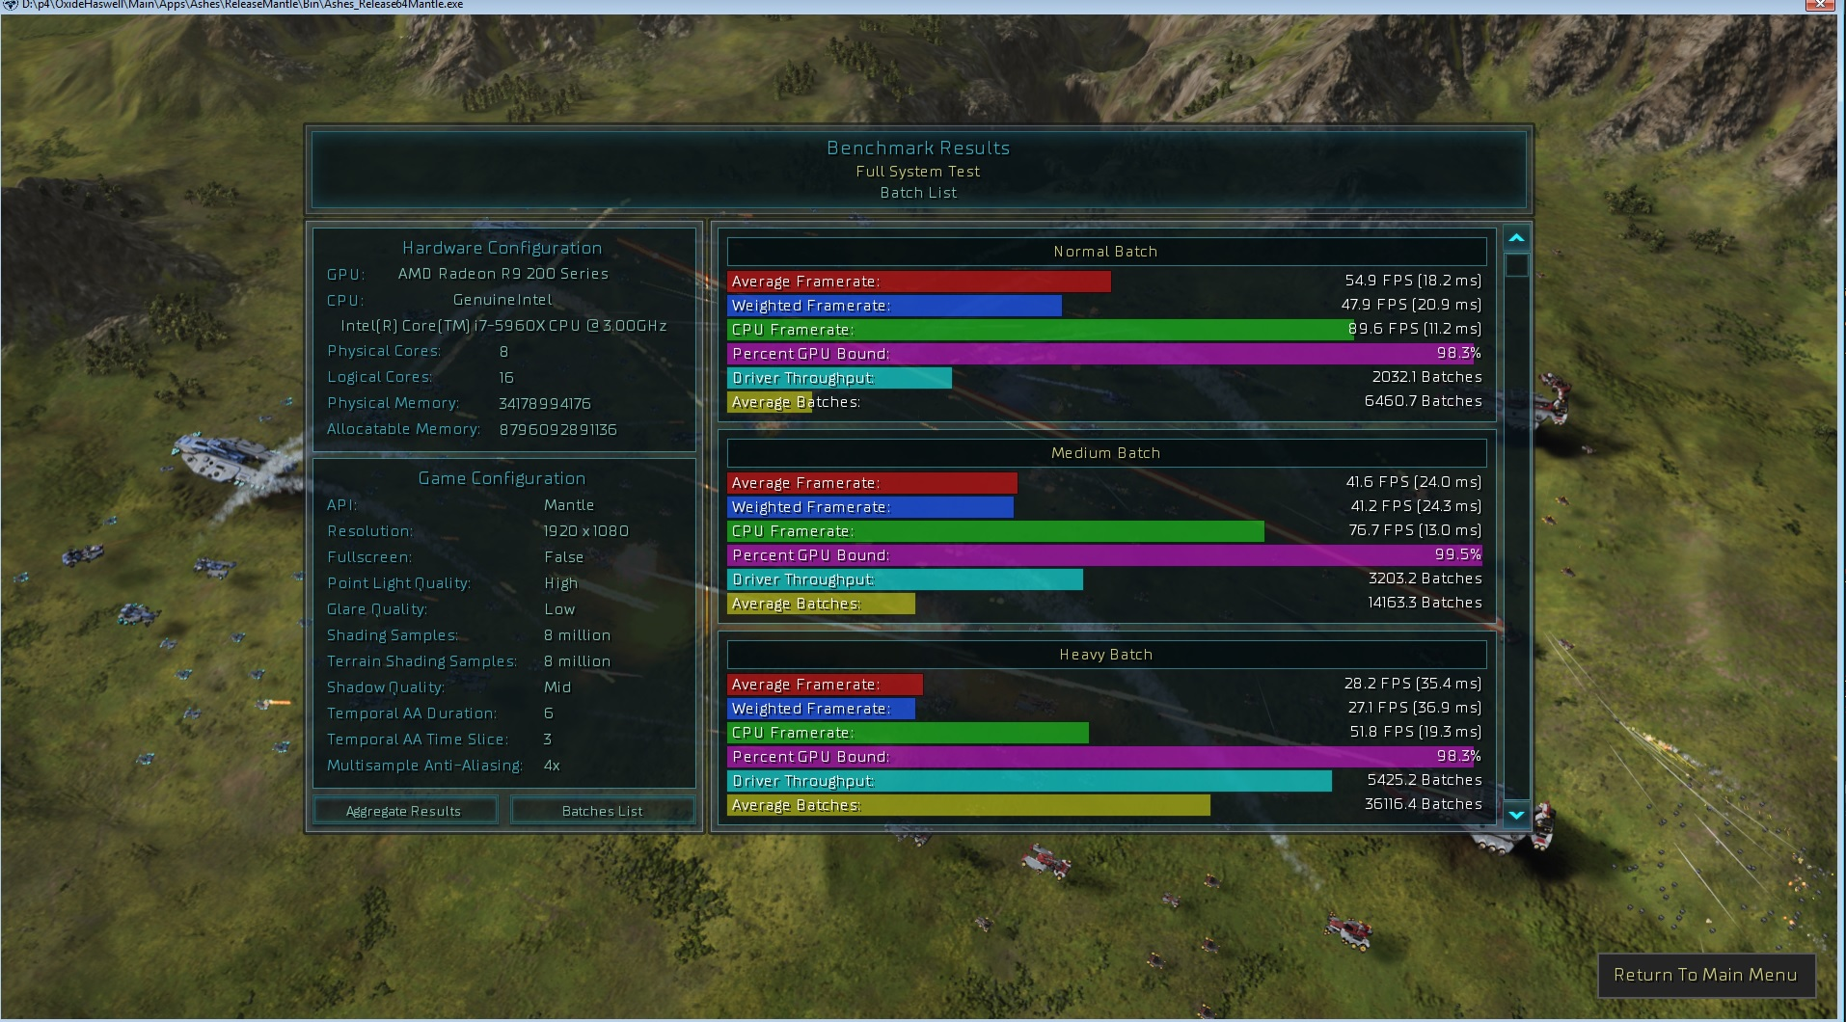
Benchmark

Slide 27
Questions?
Tech questions dan.baker@oxidegames.com
Press questions: Stephanie Tinsley Stephanie@Tinsley-PR.com

