Slide 1


Slide 2
Direct3D12
Chas. Boyd
Principal PM Microsoft OSG Graphics
Notes:
Goal is to highlight details in a few areas that are newest (haven’t been presented before)
Also provide a deeper explanation of why: philosophy.

Slide 3
Outline
Overall objectives of DirectX12
Schedule -shipped last week
DirectX12 Execution Model:
  Root Signatures, ExecuteIndirect, Multi-engine, Multi-adapter
Tools, debugging
Hardware Feature Levels and Tiers

Slide 4
Direct3D
The 3D Graphics API for DirectX
Targeted primarily at games
Innovation and evolution over time
Balance:
  Ease of programming
  Hardware features
  Performance

Slide 5
Evolution
1995 DirectX 1 DirectDraw, hardware blit and page flip
1996 DirectX 2 Direct3D, software render, execute buffers
1996 DirectX 3 Hardware-accelerated rasterization
1997 DirectX 5 DrawPrimitive, dual-texture, 1-bit ‘shader’
1998 DirectX 6 Multi-texture blending, DXTC compression, bump mapping
1999 DirectX 7 Hardware vertex processing transformation and lighting.
2000 DirectX 8 First Programmable shaders
2001 DirectX 8.1 More instructions
2002 DirectX 9 High Level Shading Language, shaders of 32 instructions
2003 DirectX 9.0c float pixels, HLSL with 1000s of instructions per shader
2006 DirectX 10 Caps-free, geometry shaders,
2009 DirectX 11 Tessellation, DirectCompute
2012 DirectX 11.1 Performance and ARM CPU support
2013 DirectX 11.2 Tiled resources (aka megatexture)
2015 DirectX 12 Performance: Multithreading, Multi-Engine, Multi-adapter
Notes:
Evolution of DirectX releases and key features of each version

Slide 6
Direct3D 12
This version is about performance
API/DDI model runs on most current GPUs
  Don’t wait for hardware installbase
Optimizes entire stack: app, engine, driver, os, gpu
  Especially the driver
Result is major shift in work distribution
A more ‘Direct’ API
Notes:
Work is more consistent, less magic behind the scenes
Back in 2007, we noticed that drivers were analyzing command streams to identify scheduling and parallelism opportunities.
This is a potentially unbounded search problem, not something you want to have happen on every Draw call.

Slide 7
Core Features
Command buffers and queues
Resource indexing and tables
  Heaps, resources, views
  Resource transitions are finite duration
Pipeline State Objects
  With caching
Execution Model

Slide 8
Asynchronous Resource Access
Execution is not constrained by resource access pattern
  No enforced serialization of access to memory objects
Resource synchronization is now ‘opt-in’

Slide 9
A GPU Function Call
Executing code on the GPU is *like* calling a function
GPUs have special memory for the function ‘arguments’
This is not a stack, but very fast 32-bit ‘registers’
Apps can use this to pass in high-frequency-change parameters like constants or resources (via descriptors)
Notes:
Language-style explanation: Executing code on the GPU is like a function call. It is asynchronous since it runs on a separate core, but it still a call.
It turns out that the hardware has some memory that can be used to pass the arguments of that function call.
This makes sense since all our GPU code uses register-based calling conventions.

Slide 10
GPU Root Arguments
Resource descriptors take 2 DWORDs
Matrices take many constants…
What if you need more than 32-64 DWORDs of state?
Create a constant buffer and specify it’s descriptor
Create a resource descriptor table and specify its index
The root signature is the declaration of these arguments
The root signature is the definition (number, types, etc) of these arguments

Slide 11
Root Signature
Root Signature defines the number of arguments and their types:
  Constants
  Descriptors
  Descriptor Tables
Performance improves with fewer DWORDs used
  Keep argument list short
Try not to change this signature too often
  A few times per frame
Notes:
Analog of function signature and function call arguments
The main( int argc, char *argv[] ) {}; for your GPU code

Slide 12
Using Root Signatures
Defined using API syntax so both App and Driver agree
Specified as part of PSO creation
  PSO will likely have many dependencies on it
Separate signature for graphics and compute tasks

Slide 13
API – Root Parameter Types
struct D3D12_ROOT_SIGNATURE_SLOT
{
D3D12_ROOT_ARGUMENT_TYPE ArgumentType;
union
{
D3D12_DESCRIPTOR_TABLE_LAYOUT DescriptorTable;
D3D12_ROOT_CONSTANTS Constants;
D3D12_ROOT_DESCRIPTOR Descriptor;
}
…
}

Slide 14
Root Signature Creation
D3D12_ROOT_SIGNATURE_SLOT SigSlots[4];
ID3D12RootSignature* pSig;
SigSlots[0].ArgumentType = D3D12_ROOT_ARGUMENT_32BIT_CONSTANTS;
SigSlots[1].ArgumentType = D3D12_ROOT_ARGUMENT_CBV;
SigSlots[2].ArgumentType = D3D12_ROOT_ARGUMENT_DESCRIPTOR_TABLE;
SigSlots[3].ArgumentType = D3D12_ROOT_ARGUMENT_DESCRIPTOR_TABLE;
…
pDevice->CreateRootSignature(SigSlots, sizeof(SigSlots), &pSig);

Slide 15
Setting Root Arguments
pCommandList->SetGraphicsRootSignature(pSignature);
pCommandList->SetGraphicsRoot32bitConstant(0, BaseOffsetInCBV);
pCommandList->SetGraphicsRootConstantBufferView(1, CBVDescriptorHandle);
pCommandList->SetGraphicsDescriptorTable(2, SamplerDescriptorTable);
pCommandList->SetGraphicsDescriptorTable(3, TextureDescriptorTable);
Notes:
This is how you actually set the values that you are passing in to the GPU via the root arguments

Slide 16
HLSL Works Unchanged
cbuffer DrawConstants
{
UINT ConstantBufferOffset;
} : register(b0)
Buffer ObjectPerDrawParams : register(t7);
Texture2D ObjectTextureArray[5] : register(t2);
Sampler ObjectSamplers[2] : register(s0);

Slide 17
Can Define Signature in HLSL
#define MyRS1 "RootFlags( ALLOW_INPUT_ASSEMBLER_INPUT_LAYOUT | " \
"DENY_VERTEX_SHADER_ROOT_ACCESS), " \
"CBV(b0, space = 1), " \
"SRV(t0), " \
"UAV(u0), " \
"DescriptorTable( CBV(b1), " \
"SRV(t1, numDescriptors = 8), " \
"UAV(u1, numDescriptors = unbounded)), " \
"DescriptorTable(Sampler(s0, space=1, numDescriptors = 4)), " \
"RootConstants(num32BitConstants=3, b10), " \
"StaticSampler(s1)," \
"StaticSampler(s2, " \
"addressU = TEXTURE_ADDRESS_CLAMP, " \
"filter = FILTER_MIN_MAG_MIP_LINEAR )"
Notes:
If you want to define the root signature using a shader syntax, you can.

Slide 18
ExecuteIndirect()
Perform multiple Draws with a single API call
‘Arguments’ of Draw calls come from a buffer
  App defines buffer contents via a ‘command signature’ struct
Number of draws can be controlled by CPU or by GPU
Works on all DirectX12-capable hardware from FL 11.0 and up
Notes:
Much like everything else in DirectX, we’ve abstracted the nuances of all the hardware and enabled this feature on every 12 GPU

Slide 19
ExecuteIndirect Cmd Signature
Operations performed by ExecuteIndirect described by a ‘command signature’
Describes the layout of the argument buffer and the set of commands
Operations include:
  Set vertex or index buffer
  Change root constants
  Set root resource views (SRV, UAV, CBV)
Draw, DrawIndexed, or Dispatch
Notes:
Currently Draw call type is set for the entire buffer, at least on PC. Since PSO is fixed for the entire command. At least currently on PC.

Slide 20
ExecuteIndirect vs Draw Loop
for (UINT drawIdx = drawStart; drawIdx < drawEnd; ++drawIdx)
{
// Set bindings
cmdLst->SetGraphicsRootConstantBufferView(RT_CBV, constantsPointer);
constantsPointer += sizeof(DrawConstantBuffer);
auto textureSRV = textureStartSRV.MakeOffsetted(staticData->textureIndex, handleIncrementSize);
cmdLst->SetGraphicsRootDescriptorTable(RT_SRV, textureSRV);
cmdLst->DrawIndexedInstanced(dynamicData->indexCount, 1, dynamicData->indexStart, staticData->vertexStart, 0);
}
mCmdLst->SetGraphicsRootDescriptorTable(RT_SRV, mTextureStart);
mCmdLst->ExecuteIndirect(mCommandSignature, settings.numAsteroids, frame->mIndirectArgBuffer->Heap(), 0, nullptr, 0);

Slide 21
ExecuteIndirect() Performance
 | DX11 | DX12 | DX12 Bindless | DX12 ExecuteIndirect
CPU | 39.19 ms | 33.41 ms | 28.77 ms | 5.69 ms
GPU | 34.81 ms | 12.85 ms | 11.86 ms | 10.59 ms
FPS | 13.5 fps | 21.6 fps | 24.6 fps | 60.0 fps
Notes:
Total CPU time
Some simple apps have been able to put almost all their work for a given frame into one ExecuteIndirect call.
Orders of magnitude reduction in CPU API overhead.

Slide 22
Multi-Engine

Slide 23
Multi-Engine
GPUs contain multiple cores today
  3D Cores, compute cores, copy engines, etc.
In most hardware these can operate asynchronously
  Some variance in granularity of pre-emption

Slide 24
Programming Model in DirectX11
CPU0
CPU1
GPU
CPU2
CPU3

Slide 25
Asynchronous Execution in DirectX 12
CPU0
CPU1
Graphics
Engine
Copy Engine
Copy Engine
Copy Engine
CPU2
CPU3
Compute
Engine
Notes:
And there are other components on there like the encoders and decoder and the display scan-out engines, etc.

Slide 26
Multi-Engine Model
All of these are just cores aka ‘engines’
  They can be invoked asynchronously
Model is a queue per core for independent async operation
  A queue guarantees serial order of execution on a single engine
Can specify priorities between queues
  Enables background processing in ‘idle’ clock cycles
And also implement semaphores across queues
Notes:
Implementations vary only in the granularity of pre-emption.

Slide 27
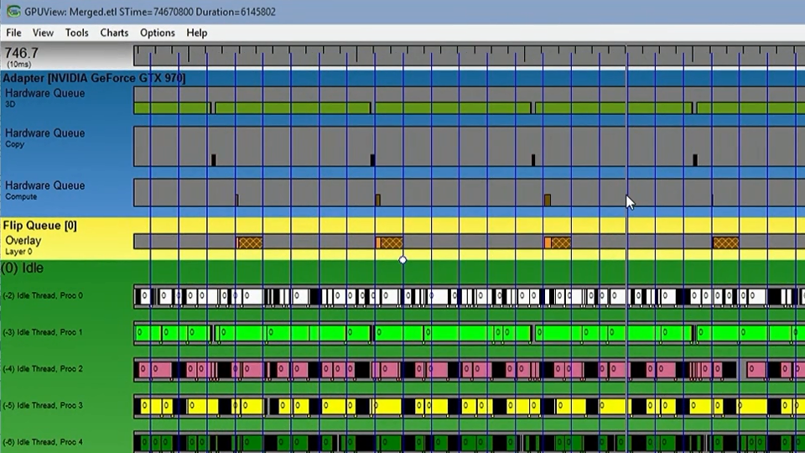

Slide 28
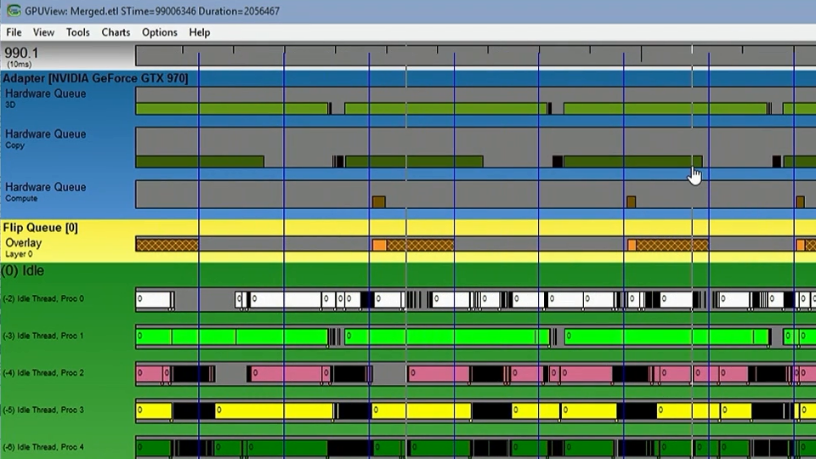

Slide 29
Multi-Engine Hierarchy
3D
Compute
Copy
Queue Types: 3D, Compute, Copy
Notes:
Extract all the parallelism out of the hardware that’s available
Why do we have these nested? Because that’s how the hardware actually works:
Really the 3D engine can do anything. It can do compute tasks and also the highest bandwidth copy tasks.
A compute queue is just using the 3D engine when you know you can power down the graphics-specific portions of that core.
A copy queue can be done on a separate blitter core aka DMA engine.

Slide 30
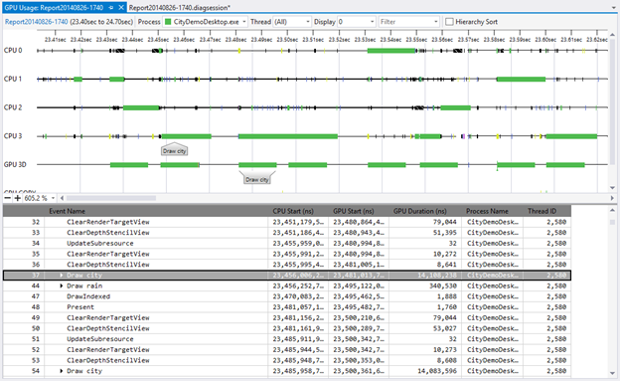
Tools for Multi-Engine
Notes:
This shows how the model is even expressed in the tools.
You can see that the GPU engines (3D, and Copy) are peers to the CPU cores in the model.

Slide 31
Multi-Engine Scenario
Hybrid Device
  Main rendering on discrete GPU
  Asynchronous copy engine sends image to integrated GPU
  Discrete GPU can start on next frame
  Integrated GPU applies post processing fx
Prototype of this is working now
Notes:
We see benefits from this, and they increase as the performance of the integrated GPU grows.

Slide 32
Multi-adapter

Slide 33
Multi-adapter
PCs can contain multiple Graphics Cards
Some graphics cards have multiple GPUs
Applications should be able to assign work to any engine on any graphics card
And create memory resources on any engine’s memory
Notes:
Driver can over-ride app if it thinks it can improve performance.

Slide 34
Multi-adapter
App can enumerate ‘adapters’ (graphics cards) from PCI
  Can create a D3D Device for each
Each adapter may have multiple ‘nodes’ (GPUs)
  Each with own engines and memory
Apps can create queues on any engine and submit command buffers
Apps can allocate resources in memory associated with any GPU
Notes:
Drivers can ‘link’ multiple adapters to make them look to the app/runtime as a single adapter.
Usually won’t do this unless/until the app does a poor job.

Slide 35
Hardware Model
PCIe
GPU
CPU GPU
GPU
GPU
...

Slide 36
More API Capability:
Predication, Queries, and Counters
  Efficiently managed in large numbers via heap model
Resource transitions are finite duration

Slide 37
New Hardware Features
Conservative Rasterization
Tiled Resource Volumes
Standard Swizzle
Raster Ordered Views
Compute Shader Pixel Format Conversion
Notes:
Hardware ecosystem is not standing still
ROVs enable spatial random access, but temporal serialization.
Useful when starting from a graphics tasks and writing to a general data structure (UAB)
E.g. for when you sort input triangles beforehand and want to retain that, or other algorithms where order matters.
Texture compression ASTC was on this list, but I personally messed up some paperwork on that. The hardware is still coming to the ecosystem as fast as possible.

Slide 38
Reporting Implementations
Need to inform app developers re hardware characteristics
Original model was individual caps bits
  DirectX9 had ~400 caps (~500 counting pixel formats)
Issues:
  What is good vs bad?
  Combinatoric explosion?
  What if I need multiple features for a technique?
Notes:
Did not provide indication of direction for industry
Looked to developer like millions of combinations were possible, even though there were only a few implementations
No way to know how much hardware supported the specific set of caps required for a particular technique

Slide 39
Organizing Implementations
Individual features now have ‘tiers’ e.g:
  Tiled resources tier 2
  Conservative rasterization tier 1
A ‘Feature Level’ is a grouping of tiers
  Enables devs to identify a set of features as a unit
  Orthogonal to API version!
API version number defines syntax/API used
    Direct3D 12 API supports FEATURE_LEVEL_11, _12, etc.
    Direct3D 11 API supports FEATURE_LEVEL_9_3 .. _11_3
Notes:
DX10/11 introduced Feature Level as a category for grouping implementations
DX11 first introduced Tiers with tiled resources, DX12 uses tiers for several things.
When you go back and target existing hardware, it is hard to get it to align.
These are getting simpler over time. We are able to reduce the number of tiers in the hardware as we work with the IHVs.

Slide 40
Tools
SDK layer can be enabled for detailed validation
Tools are now built in concert with the API
  Capture/Playback
  Timing Analysis
  Visualization of intermediate results
Collaboration with the other tools teams (visual studio)
New instrumentation has been added to drivers
  Detailed stats on internal registers

Slide 41
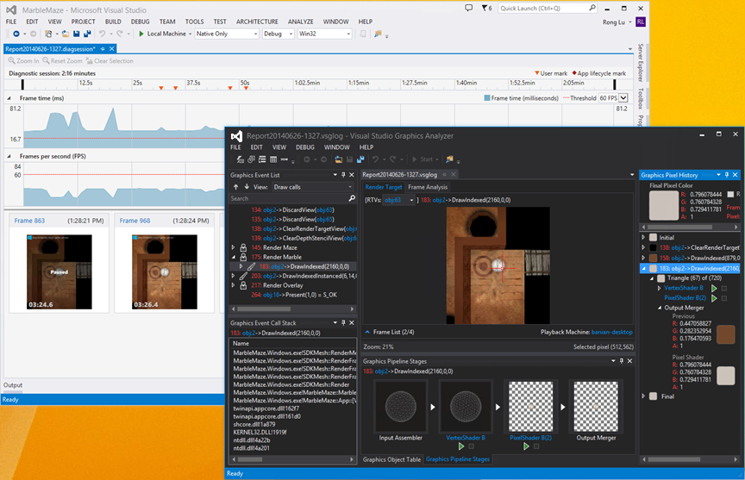
Visual Studio 2015
Visual Studio 2015
Notes:
VS 2015
Unified CPU, GPU, System profiling and debugging tool for the Universal App Platform and full breadth of Windows devices

Slide 42
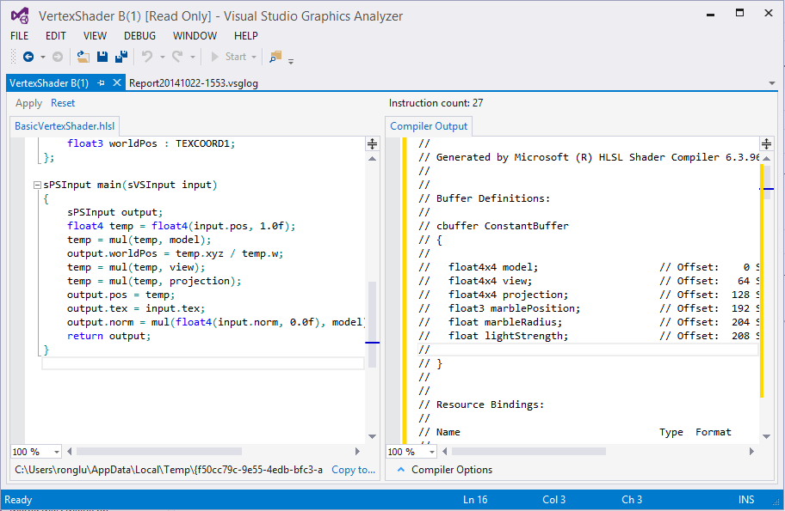
Shader Edit and Apply
Notes:
Side by side windows for HLSL source code and shader compiler output
Edit shader code and apply changes to the log file to view impacts

Slide 43
Summary
DirectX12 execution model enables
  Flexible access to CPU/GPU memory resources
  Multi-threaded scalability for CPU efficiency
  GPU side work preparation via ExecuteIndirect
  Multiple asynchronous queues: 3D, Compute, Copy
  Ability to target any processor in the machine via Multi-Engine and Multi-adapter
Notes:
GPGPU was not the main focus of DX12, yet there are several that massively improve the DirectCompute capabilities and performance
Support for multi-GPU, and for VR/Stereo.

Slide 44
Fin

Slide 45
Resources
Follow @DirectX12 on twitter
http://blogs.msdn.com/directx
Sign up for Early Access program at:
http://tinyurl.com/o9wq7fb
Or
http://1drv.ms/1pmVF6c

Slide 46
DirectX12 the Movie
BUILD 2014 https://channel9.msdn.com/Events/Build/2014/3-564
GDC 2015 https://channel9.msdn.com/Events/GDC/GDC-2015/Advanced- DirectX12-Graphics-and-Performance
GDC 2015 https://channel9.msdn.com/Events/GDC/GDC-2015/Better- Power-Better-Performance-Your-Game-on-DirectX12
BUILD 2015 https://channel9.msdn.com/Events/Build/2015/3-673 Slightly updated version of Max’s GDC 2015 talk
GDC 2015 http://channel9.msdn.com/events/GDC/GDC-2015/Solve- the-Tough-Graphics-Problems-with-your-Game-Using-DirectX-Tools

Slide 47
DirectX12 Videos
New Youtube Channel: Microsoft Graphics Education
  Talks by the developers

